Slide 1
Zerto 4.5
The Standard for Disaster Recovery

Slide 2
Agenda
Introduction and Meeting Objectives
Level Set
Zerto 4.5 Update
Production Use Cases
Next Steps

Slide 3
Agenda
Introductions
Current State
Zerto Overview
Zerto Architecture
Next Steps

Slide 4
Agenda
Introduction and Objectives
What We Heard
Point of View
Zerto’s Approach
Customer Success Stories
Next Steps

Slide 5
Zerto provides enterprise-class, virtual replication and BC/DR solutions for private, hybrid and public clouds.
Notes:
Discovery slide. Why the new deck?
Updated for 4.0 features
All new graphics courtesy of our amazing new in-house designer Marie!
Explaining the Zerto story of revolutionizing BC/DR
Position Zerto as a complete BC/DR solution
Repositioning RPO of seconds to be for everything, not just Tier 1
Dedicated slides on CDP and how to recover from a disaster
Reposition of offsite backup to be a feature benefit
Additional slides for CSPs and AWS hidden at the back

Slide 6




How Zerto Revolutionized BC/DR
Hypervisor
The first Enterprise-class, Software-Defined Replication & Recovery Automation solution
Servers
Security
Networking
Zerto Hypervisor Based Replication
Replication
Storage
Replication was in the wrong place – the physical layer
Notes:
Back in 2011 replication in enterprise virtual environments was done at the storage layer, and at Zerto we saw this was in the wrong place as you were locked into replicating between 2 matching storage arrays.
This meant that first of all you were unable to mix and match your storage between your sites, you had the complexity of replicating per lun, it was so complicated it even required a separate mgmt software for VM integration and couldn’t fully realize all the benefits of virtualization because you were tied into the physical layer.
We revolutionized BC/DR by moving the replication into the hypervisor to make it software-defined and included all of the recovery automation, removing the need for a separate solution, and enabled the simplicity of protecting on a per VM basis.
And Zerto isn’t alone in this trend, everything from your security, networking and storage is now moving into the hypervisor to realize the benefits of being software defined.

Slide 7
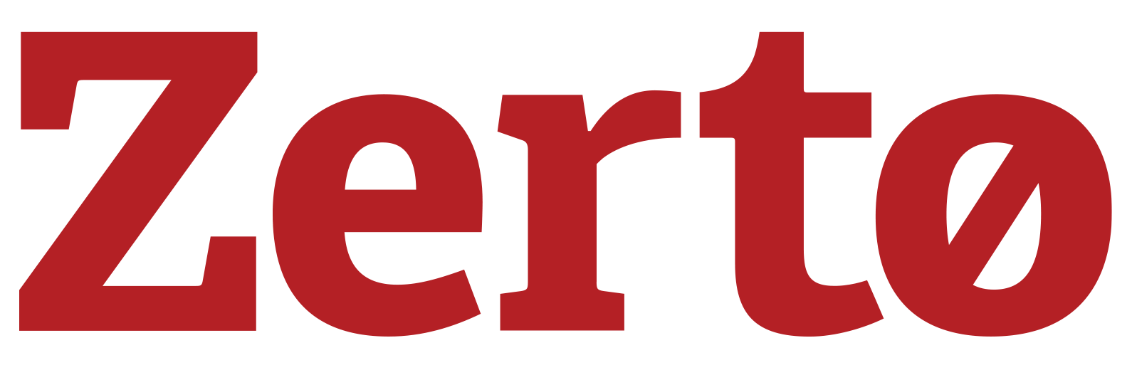



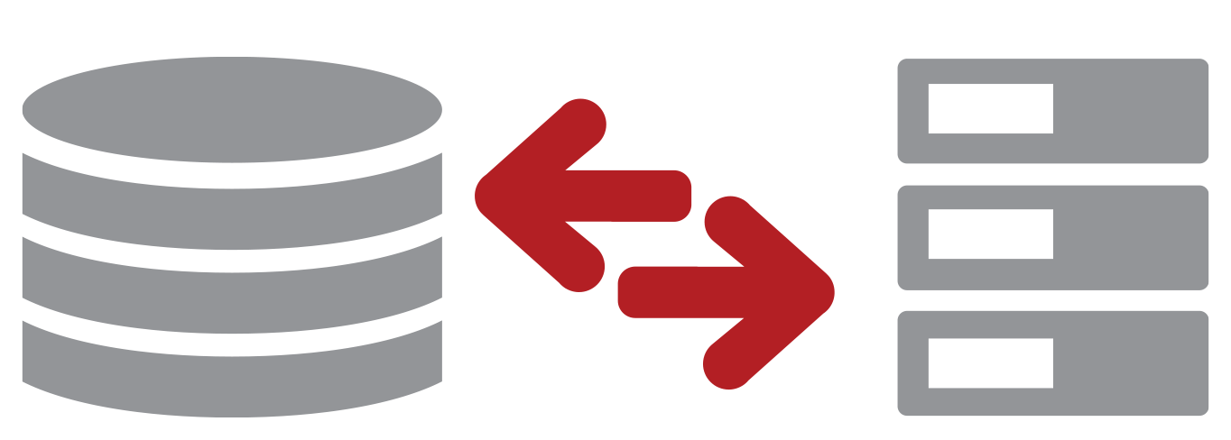
Virtual Aware
Enterprise-Class BC/DR
Software Only
Storage & Hypervisor Agnostic
Notes:
That its completely virtual aware and integrated into the virtual environment
Enterprise class meaning it will never impact the performance of the protected VMs which makes it scalable to protecting environments from 10-15 VMs to many thousands
Software only making it simple to install, simple to manage.
And now with Zerto 4.0 it also means Zerto is not only storage agnostic, its hypervisor agnostic too. Which means….

Slide 8
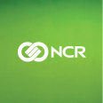







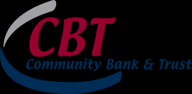


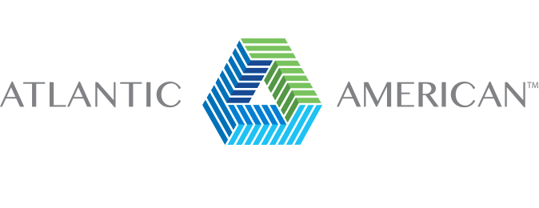







Q4 2015 Added Logos

Slide 9


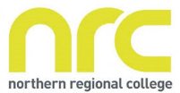







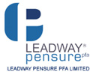




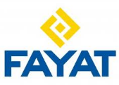














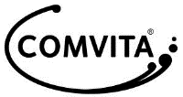




The Standard in BC/DR
2500+ Enterprise Customers 27 Countries
250+ Cloud Service Providers
600+ Channel Partners
Notes:
Since then we have doubled our customer base year on year
Added 200 cloud service providers utilizing Zerto for DRaaS
Signed 600 channel partners trained on the Zerto solution
The reason they have all standardized their BC/DR on Zerto is….

Slide 10

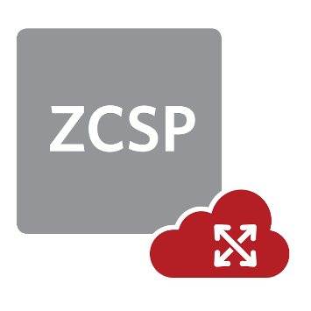

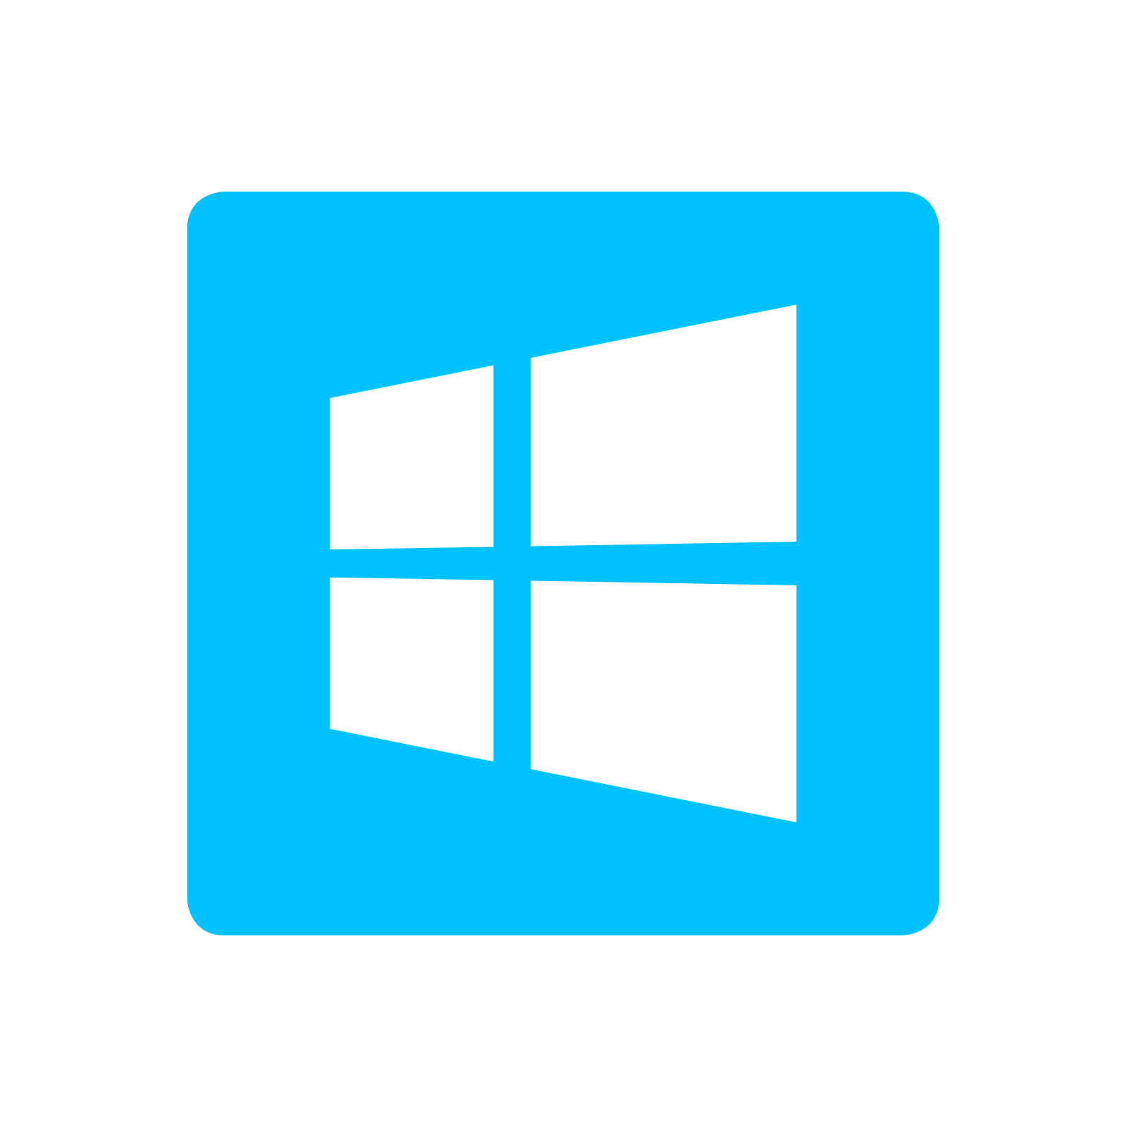

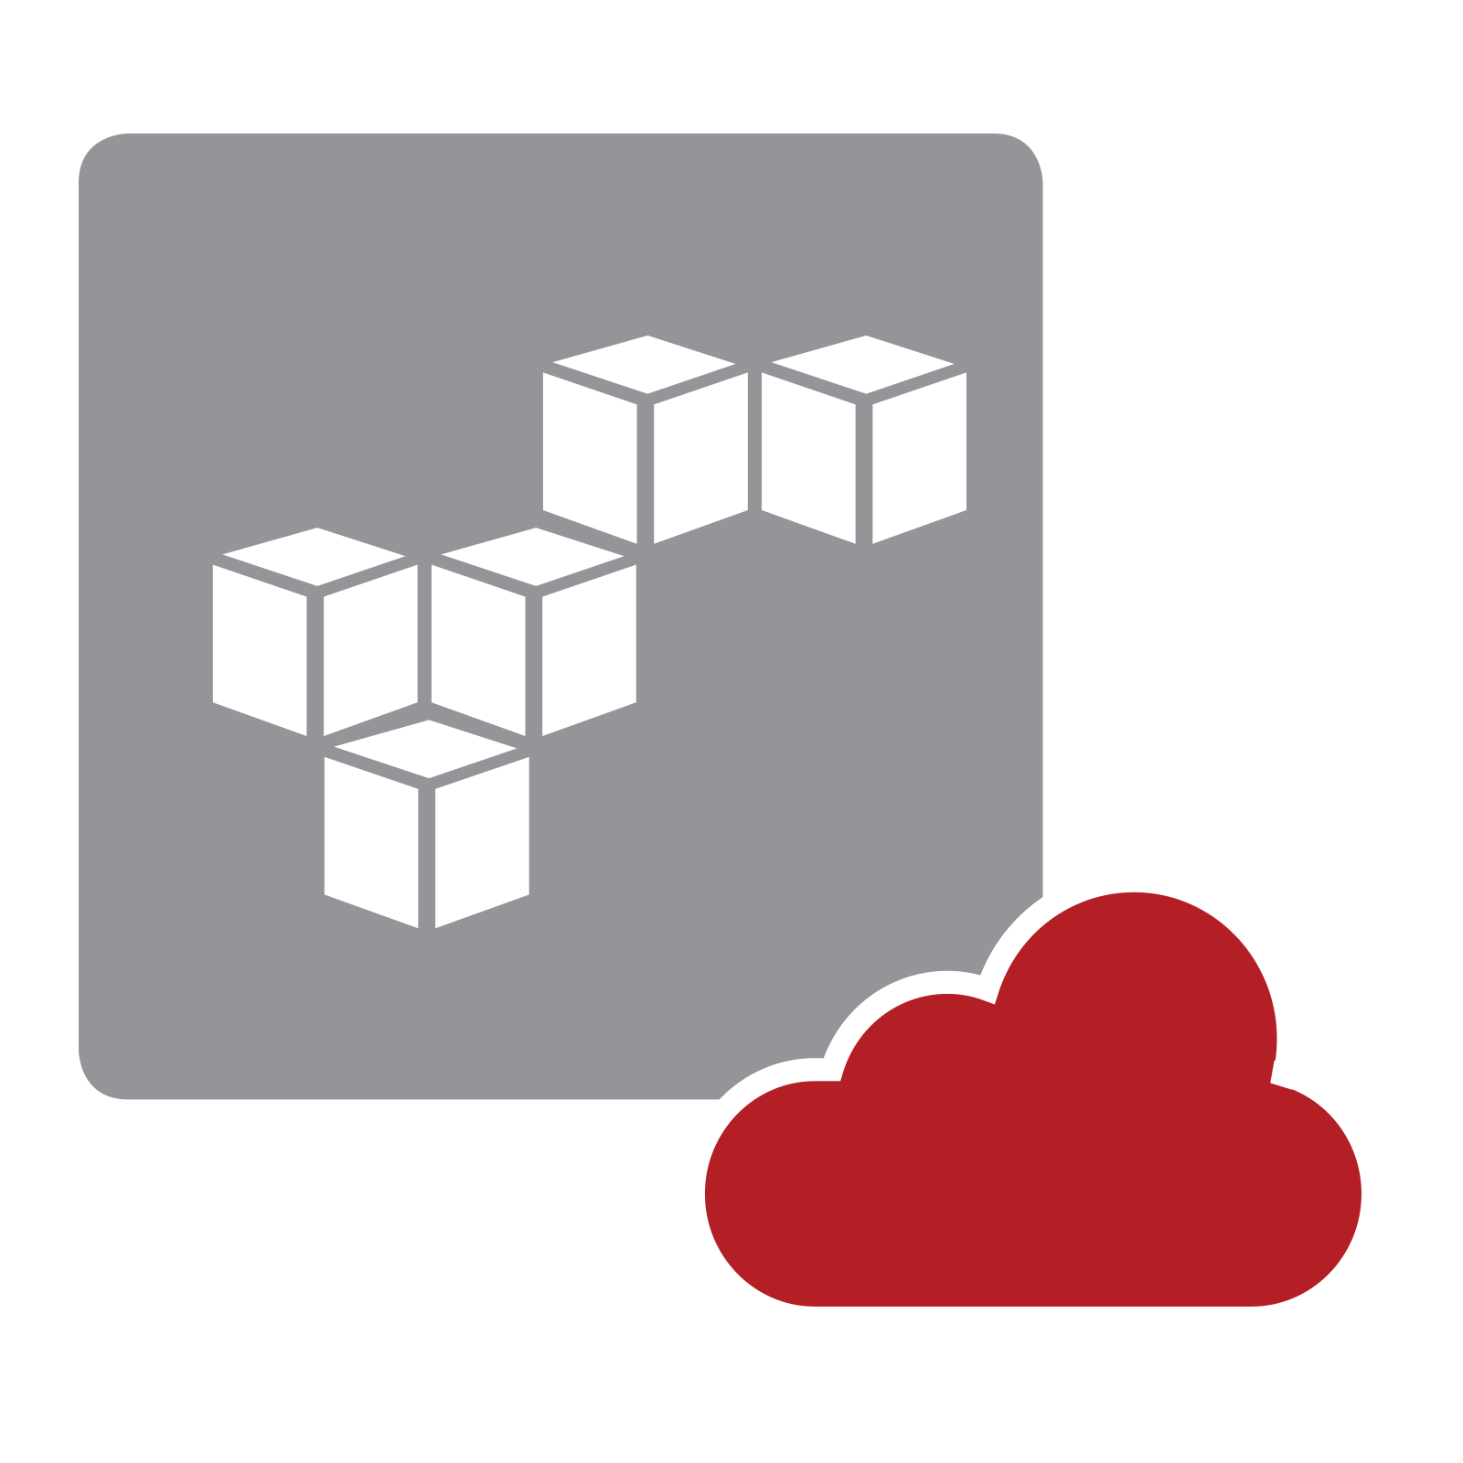

One Strategic Software Solution
1
Private Cloud – Any Storage Multi-Hypervisor
3
Hybrid Cloud – DRaaS, Intra-Cloud & Reverse DRaaS
+200
2
Satellite Offices – Any Distance
4
Public Cloud – DRaaS to AWS
Notes:
With one strategic software solution using one interface, platform and skillset you can protect and recover VMs between your VMware vSphere environments in a private cloud
Protect VMs from Microsoft Hyper-V to Hyper-V, delivering the first enterprise-class BC/DR solution for Hyper-V which in a recent Gartner study was the highlighted as the only major blocker for adoption of Hyper-V
You can even protect and recover VMs from VMware to Hyper-V in your DR site, allowing you to utilize your existing Hyper-V licenses in ways that simply weren’t possible before by giving you a cheaper option for your BC/DR site hypervisor
Even if you are not considering Hyper-V today, in 2-3 years time you might need to switch hypervisors due to the cost savings of Hyper-V or the feature benefits catching up on VMware
With Zerto you can migrate from VMware to Hyper-V then re-utilize the same license to protect the VMs between Hyper-V environments. If you were to use a competing BC/DR solution your investment is more than likely wasted in this scenario, but not with Zerto.
We support replicating from multiple satellite offices running Hyper-V or VMware into a centralized datacenter over any distance.
You can remove the requirement for managing your own BC/DR site altogether by replicating to one of our 200 Zerto Cloud Service Providers you can move to an OPEX model, have a managed service which is especially useful in the event of a disaster as you have someone to call to initiate and manage the failover process for you
In Zerto 4.0 we also now support replicating to public cloud, specifically AWS, bringing public cloud into your BC/DR strategy and allowing you to just pay for the storage used for replication

Slide 11
Building a Complete BC/DR Solution
Disaster Recovery Automation
Enterprise
Class
Virtual
Replication
Continuous Data
Protection
Offsite
Backup
Simplicity
Notes:
In order to build a complete BC/DR solution to protect your virtual environment the first thing you need is
Enterprise class virtual replication to realize the benefits of being software defined
Continuous data protection giving you the ability to recover down to increments every few seconds to minimize data loss
The ability to click to test, click to failover and recover in minutes with disaster recovery automation
And finally an offsite backup of the data to ensure that you can always recover
You can install and manage multiple points solutions for all of these features today to give you complete BC/DR protection and if you do this one thing you wont have is simplicity
Zerto is the only software solution in the world today that gives you all the feature sets you need for a complete BC/DR solution is one simple to use and easy to manage interface
I’m now going to take you through how Zerto delivers all the feature sets you see here starting with Enterprise Class Virtual Replication…..

Slide 12



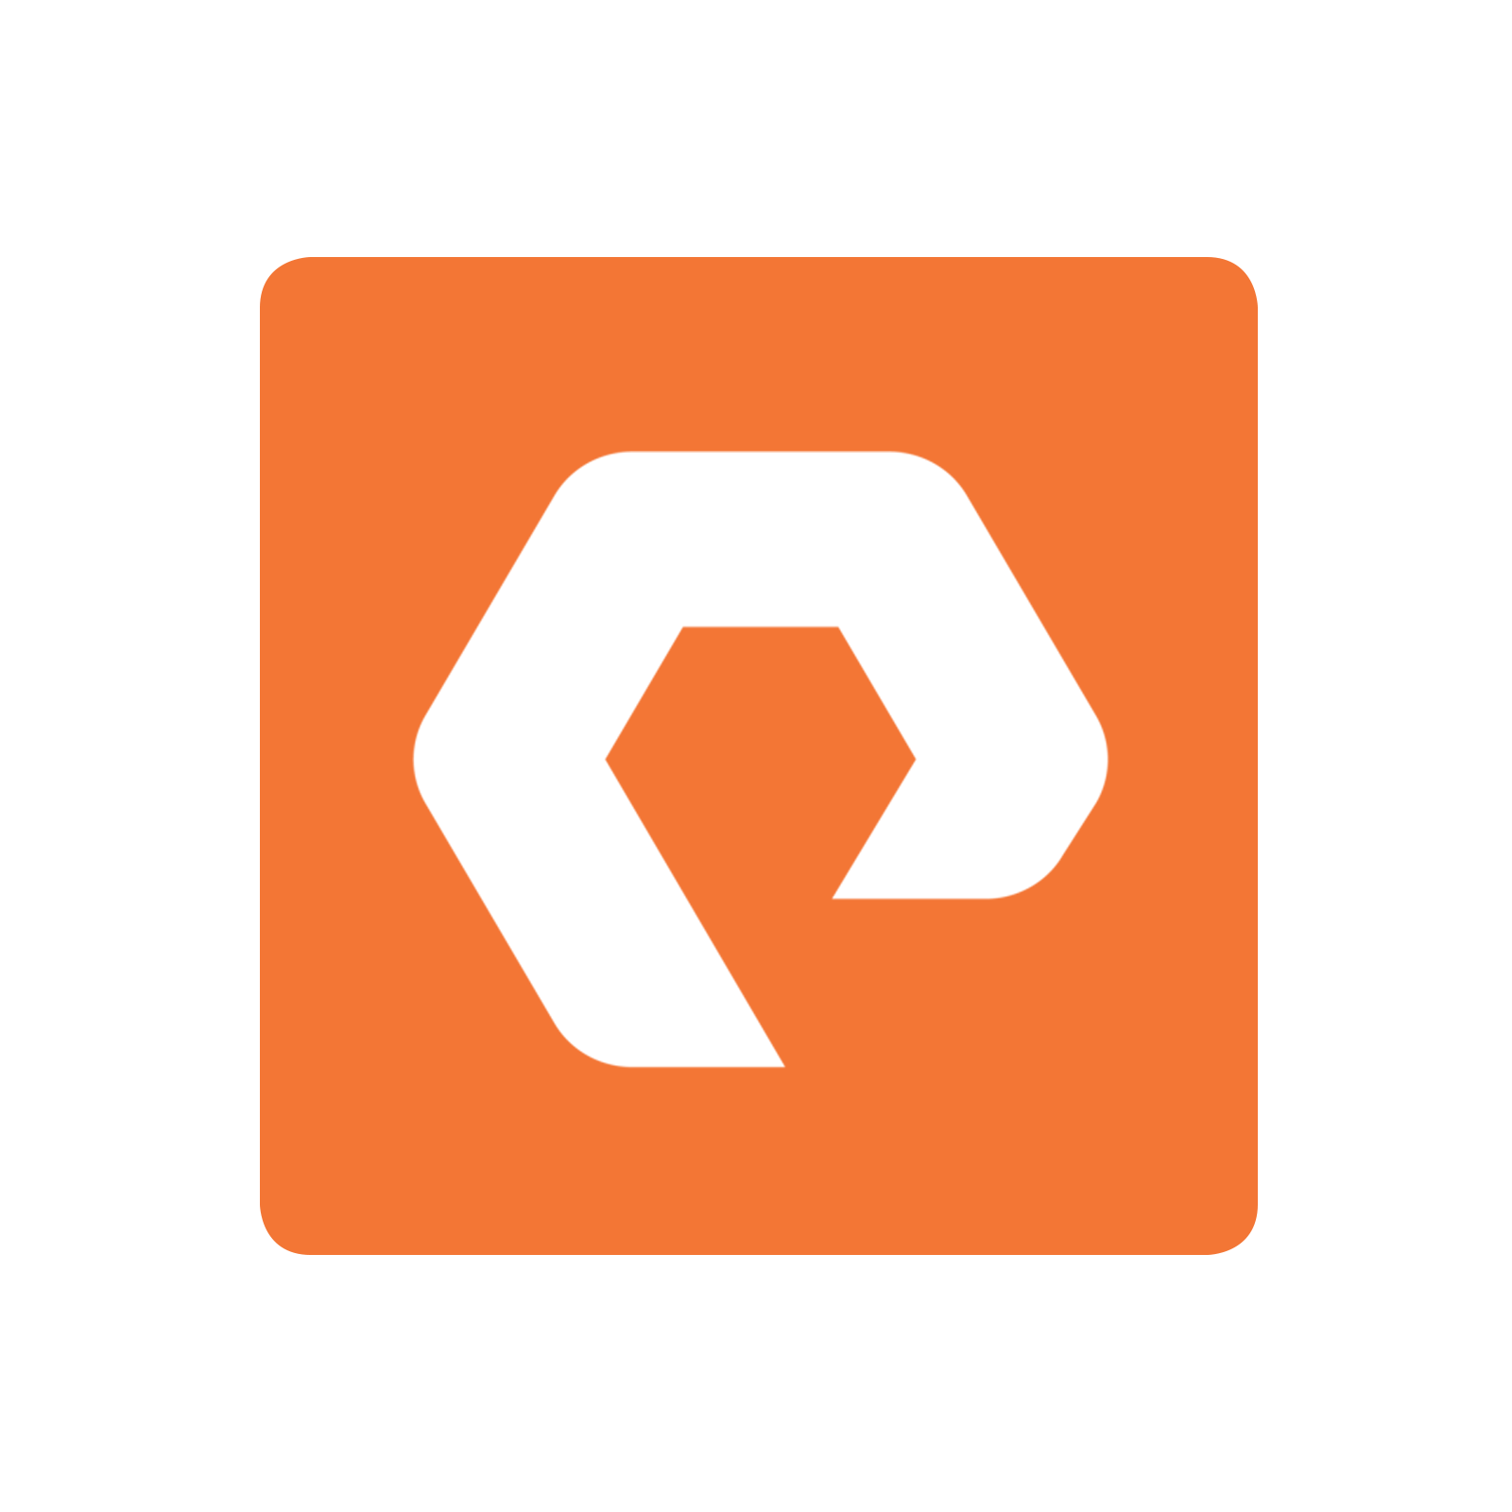

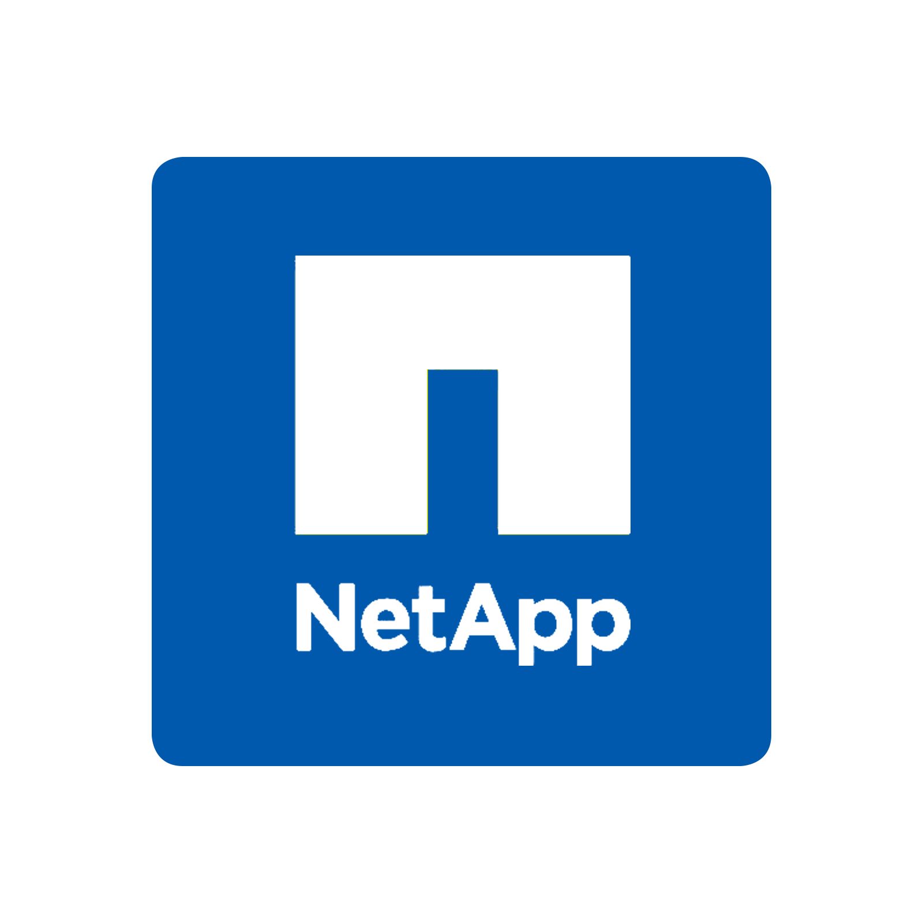
Enterprise Class Virtual Replication
Software only Install in Minutes No downtime
Hypervisor-based Highly scalable
Compression, throttling, resiliency
Production Site
BC/DR Site
vCenter
ZVM
Mgmt
ZVM
WAN
VM
VRA
VM
VRA
VM
VRA
VM
VRA
VM
VM
VM
VM
VM-Level Replication
VM
VM
VM
VM
Continuous replication RPO = Seconds
No snapshots = no impact
Save cost & replicate from
Anything to Anything
Remove complexity, re-use HW
Notes:
Zerto protects VMs with continuous block level replication of just the changes, which means a Recovery Point Objective of just seconds minimizing data loss.
An RPO of seconds is not just important for Tier 1 applications, its just as critical for tier 2 and tier 3 applications. If you take a tier 2 application and give an SLA to the business of 24 hours, then replicate it every 24 hours then you are always red lining your replication vs your SLA, giving you no headroom to cope with large amounts of data change.
With Zerto’s continuous replication you have the headroom to cope with large amounts of data change and always meet your SLAs.
The replication doesn’t use any form of snapshots, which is how it has no performance impact and why Zerto is enterprise in class and scalable to thousands of VMs.
As Zerto replicates in the hypervisor using virtual replication appliances this is how it enables replication from any storage to any storage.
This means that you don’t have to match the storage model or vendor between sites allowing you to mix and match your storage based on performance, price and SLA, not what matches production.
Just as important is that Zerto also removes the complexity of having to configure replication in a separate interface on a per LUN basis which requires different skill sets for each storage vendor.
Zerto automatically converts VM disks and settings allowing replication between hypervisors which is not only great for disaster recovery, it can be used for migration too.
As you can appreciate converting VM settings between hypervisors is quite a complicated process, you can change the mappings that Zerto uses and we have a Cross hypervisor datasheet that shows you how all of the different VM settings are converted if you want to learn more.

Slide 13

Enterprise Class Virtual Replication
Production Site
Virtual Protection Group = Complete Application Protection
Enterprise Applications
Recover Multi-VM applications consistently
CRM, ERP, SQL, Oracle, SharePoint, Exchange
Prioritize & meet SLAs
VM
VM
VM
VM
VM
Pre-seeding, reduce initial sync
VM
VM
VM
VM
VM
Virtualization features vMotion, svMotion, HA etc
VM
VM
VM
VM
VM
VM
VM
CRM VPG
VM
VM
VM
VM
VM
RPO 4 seconds
ERP VPG
VM
VM
VM
VM
VM
RPO 6 seconds
vDisk
vDisk
vDisk
vDisk
vDisk
vDisk
vDisk
vDisk
vDisk
vDisk
vDisk
vDisk
SQL VPG
RPO 9 seconds
VM
VM
VM
VM
VM
Notes:
Enterprise applications such as CRM, ERP, SharePoint, Exchange, SQL and Oracle typically consist of multiple VMs that all work together to provide the application.
In this example we have 3 applications each consisting of 5 VMs spread across multiple hosts and storage configurations.
Zerto has the concept of a Virtual Protection Group which enables complete application protection with consistent recovery of the multi-VM to the same point in time just a few seconds in the past.
If you were to take 3 applications comprising of 15 VMs that you see here and protect them with a free replication engine, because it has no consistency grouping all of the VMs replicate on a random schedule meaning you don’t know when you can recover the application to.
With Zerto’s Virtual Protection Group you know you can recover all the VMs that form each application to the same point in time ensuring you can meet your application level SLAs.
Zerto also allows you prioritize the replication of each application so that if the bandwidth becomes constrained Zerto will automatically maintain a consistently low RPO on the high priority protection groups, and let the RPO on less important apps increase until the bandwidth becomes available.

Slide 14







Typical Data Protection Solutions
Backup
Snapshot
Snapshot
Snapshot
4h+
24h+
12:00
06:00
09:00
12:00
15:00
18:00
Power Interruption or Hardware Failure
Cryptolocker Virus Infection
File deletion, Application or Human error
= Data Loss & Downtime

Slide 15






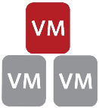

Minimize Impact
*
4.5
2 week Journal
00:00
06:00
09:00
12:00
15:00
18:00
Re-wind and recover from any point in time
Sites
Apps
*
VMs
Files
Notes:
2 week journal covers the typically reported 90%+ of data requests being within a 2 week window

Slide 16
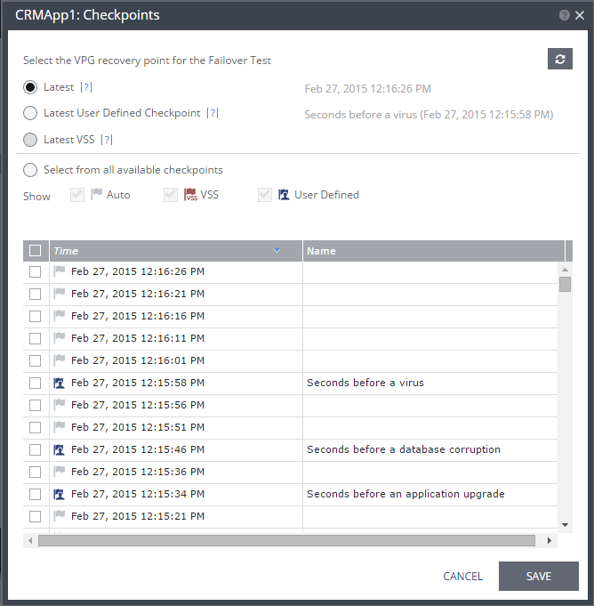
Continuous Data Protection
Simply re-wind to Any Point in Time
Protection against Logical Failures, not just disasters
Recover from Seconds ago, not the last Backup or Snapshot
Application Consistency and write-order fidelity
Recover Multi-VM Apps consistently down to the second

Slide 17
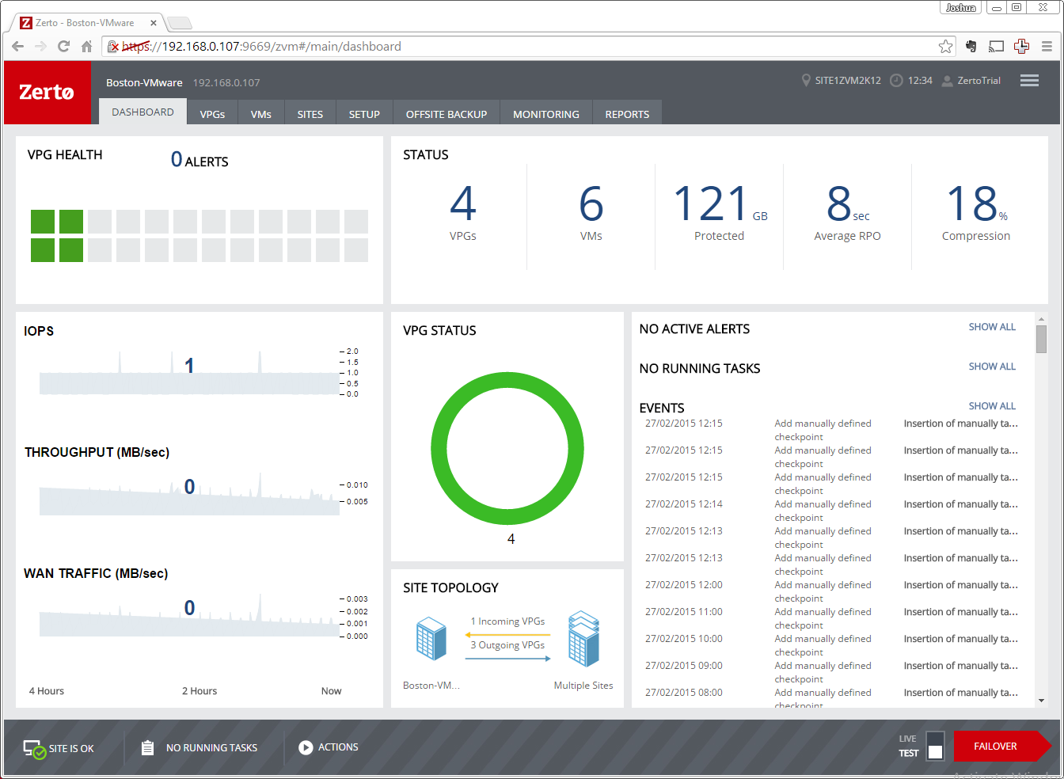
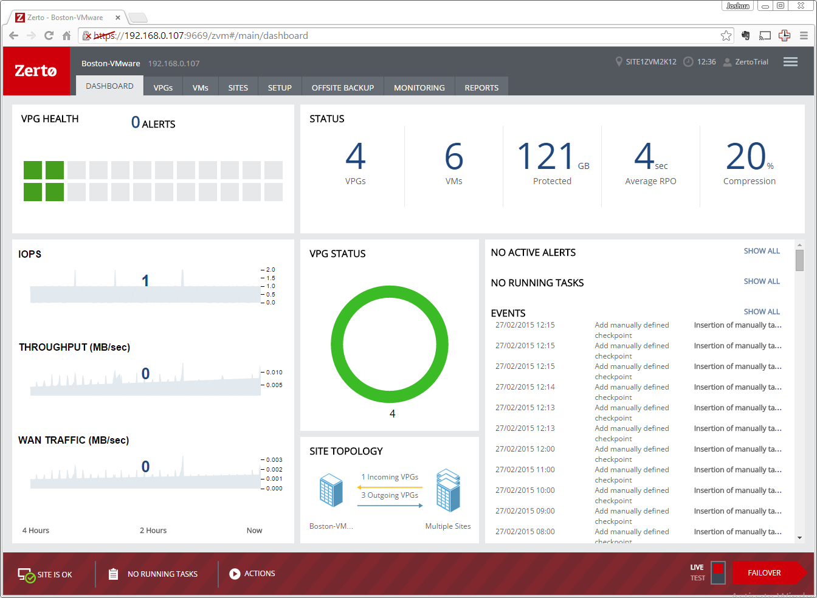
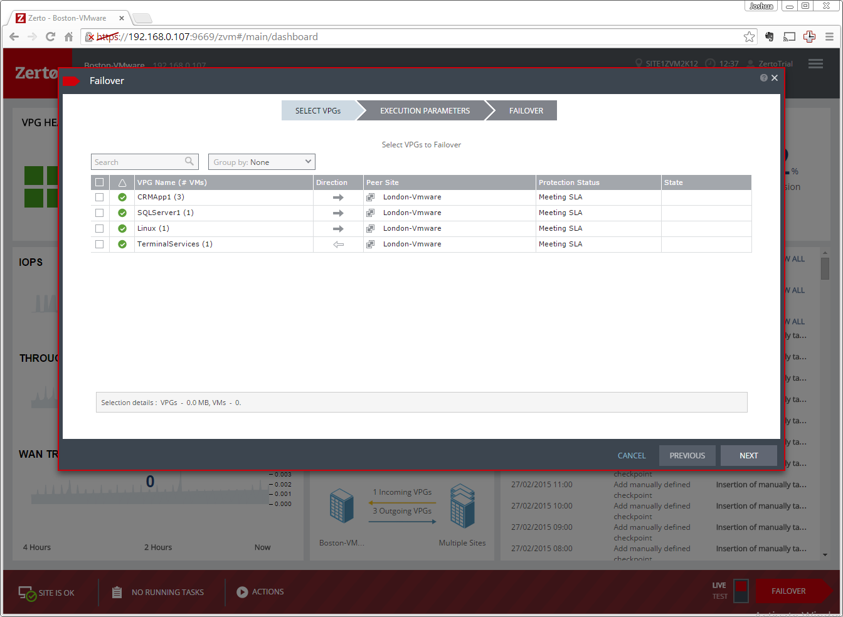
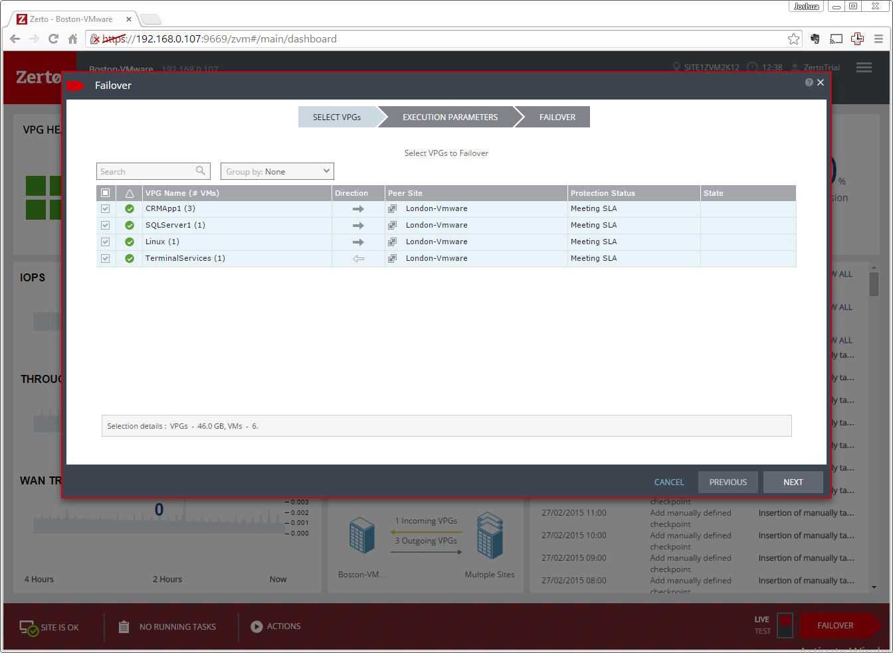
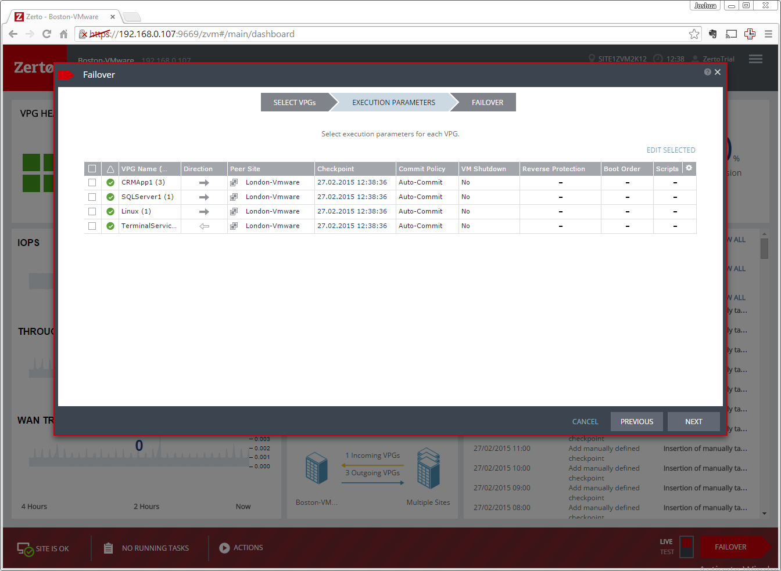
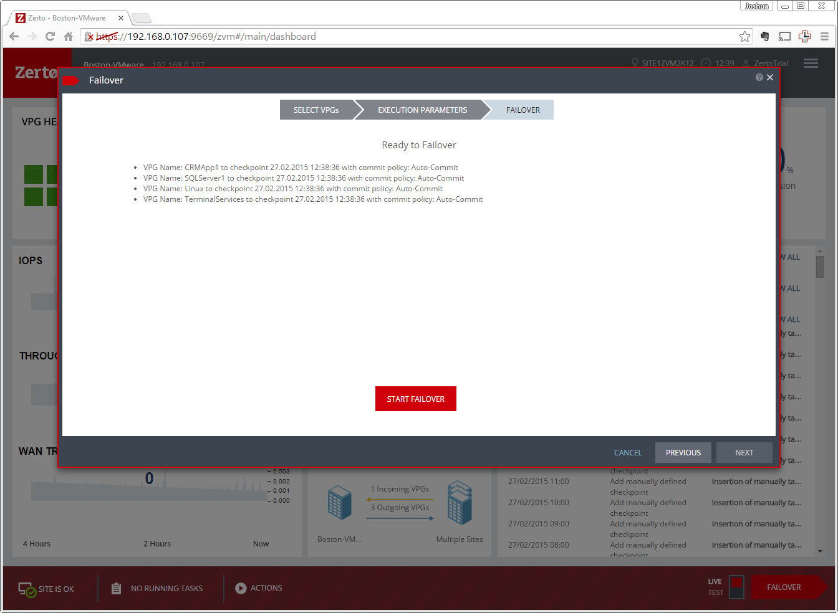
Disaster Recovery Automation

Slide 18
Disaster Recovery Automation
Automated Failback Replication of Only Changes AWS failback V2V export
Boot order, Re-IP
RTO = Minutes
Scripts & Commit Policy
Production Site
BC/DR Site
vCenter
ZVM
Mgmt
ZVM
WAN
VM
VM
VM
VM
VM
VM
VM
VM
VM
VM
VM
VRA
VM
VRA
VRA
VRA
Failover Test
Move
Recovery
Failback
VM
VM
VM
VM
VM
VM
VM
VM
VM
VM
VM
VM
VM
VM
VM
VM
VM
VM
VM
VM
VM
VM
VM
VM
Click to move
Migrate in minutes Seconds of lag, test before move
Click to test in isolated network
Non-disruptive failover testing
Not just for DR & Offsite Clone
VM
VM
VM
VM
VM
VM

Slide 19
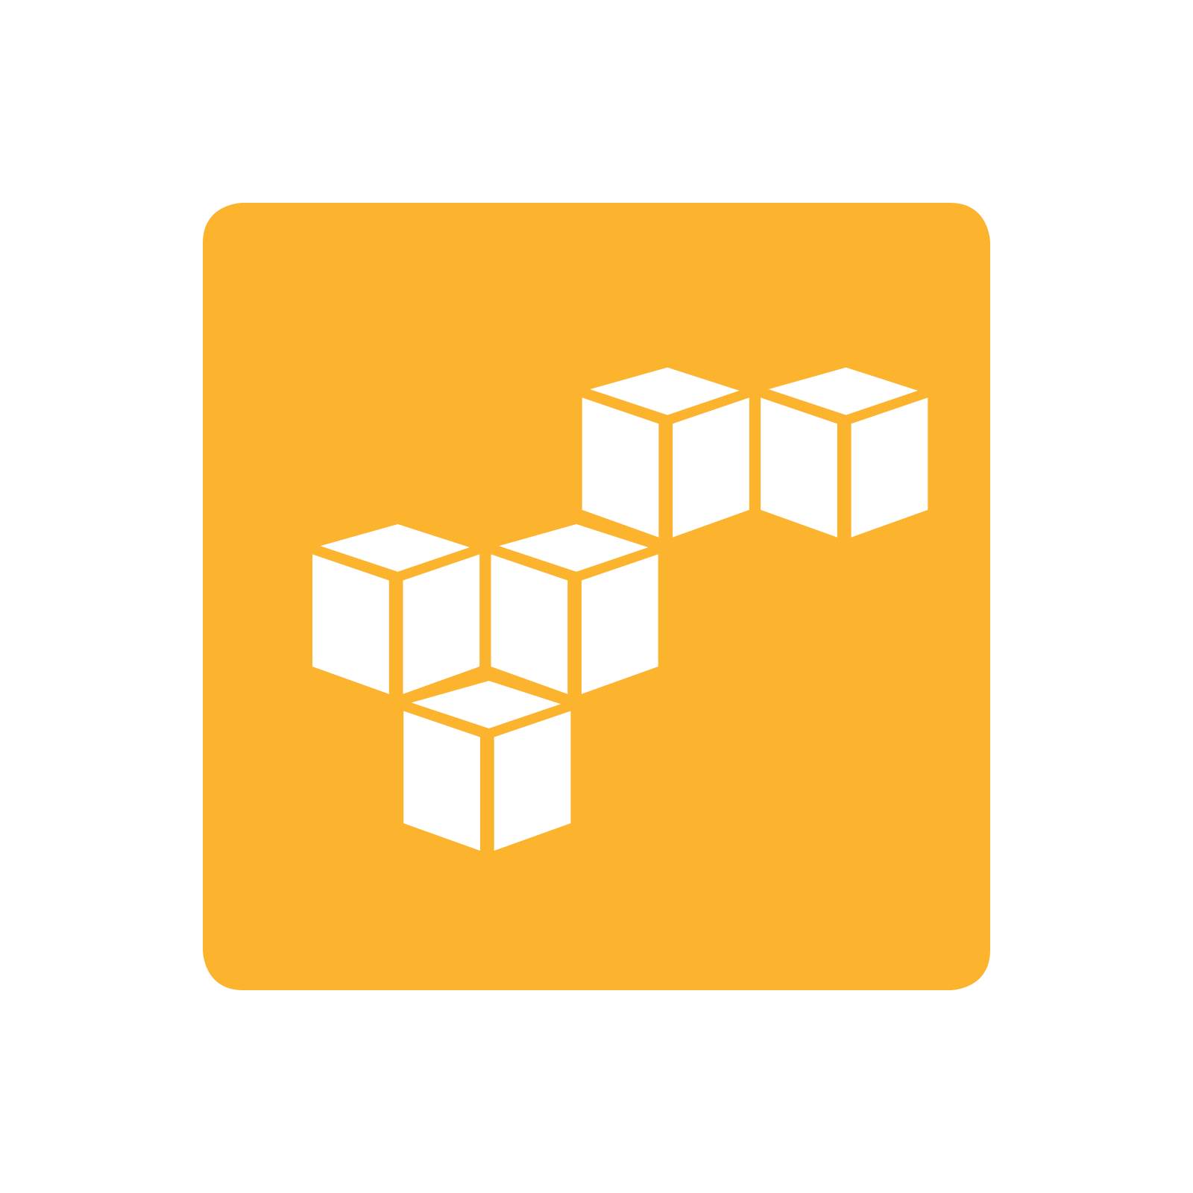
Offsite Backup
VPG backup
3rd Copy from replica data Daily, Weekly or Monthly schedule
No backup window Backup to Offsite repository in any site or public cloud
BC/DR Site
Offsite Backup
v
SCVMM
ZVM
ZVM Disk, SMB Share
VM
VRA
VM
VRA
VM
VM
VM
VM
Offsite Backup
Deduplication Device
AWS S3, Glacier
BC/DR site failure protection
Always Recover Restore to anything
Extend journal protection
Long term data retention
Keep forever
19

Slide 20
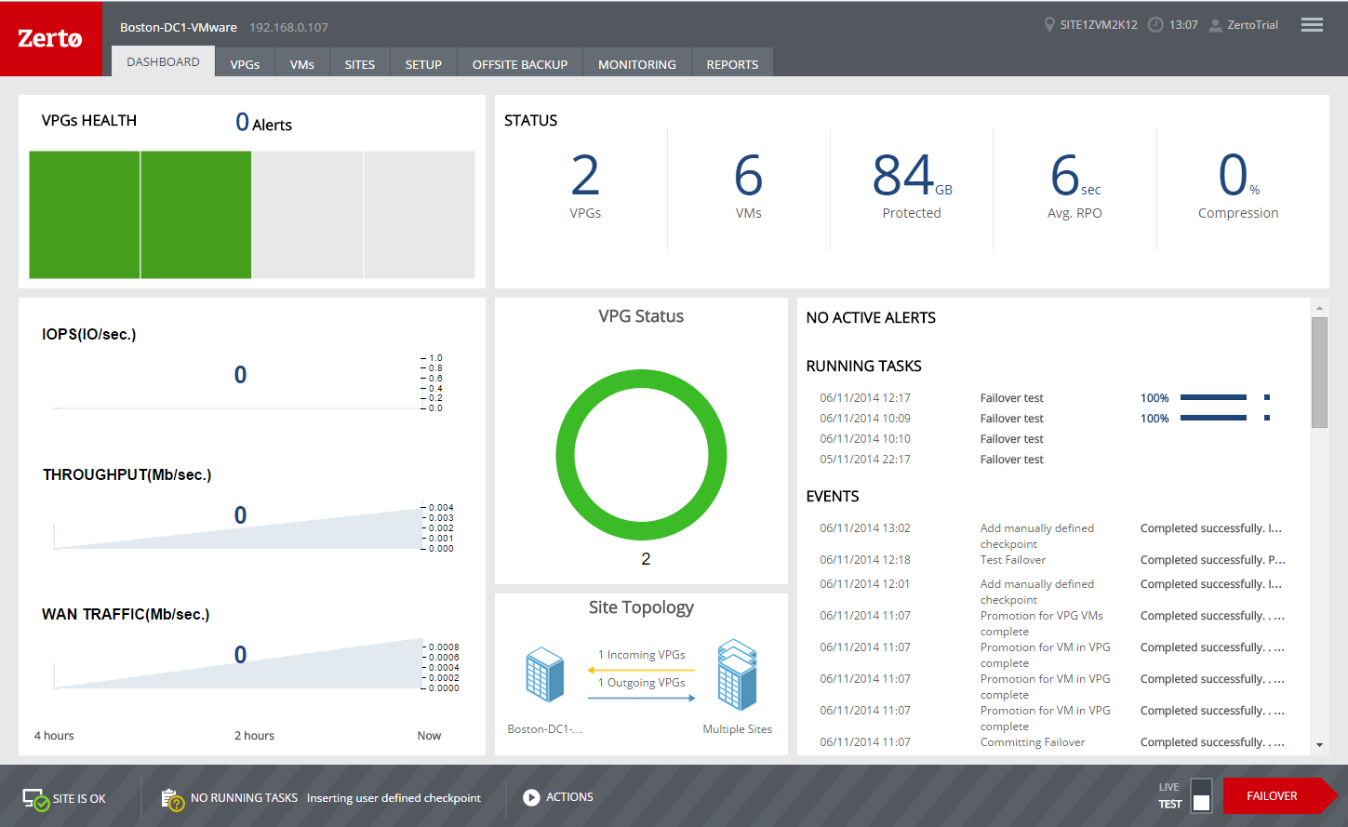
Simplicity
HTML5 tablet ready
Consistent Mgmt & Control across hypervisors
Hypervisor integrated Simple to manage
Status, KPIs, Alerts
Ensure compliance
DR Reporting
Prove recovery capability

Slide 21
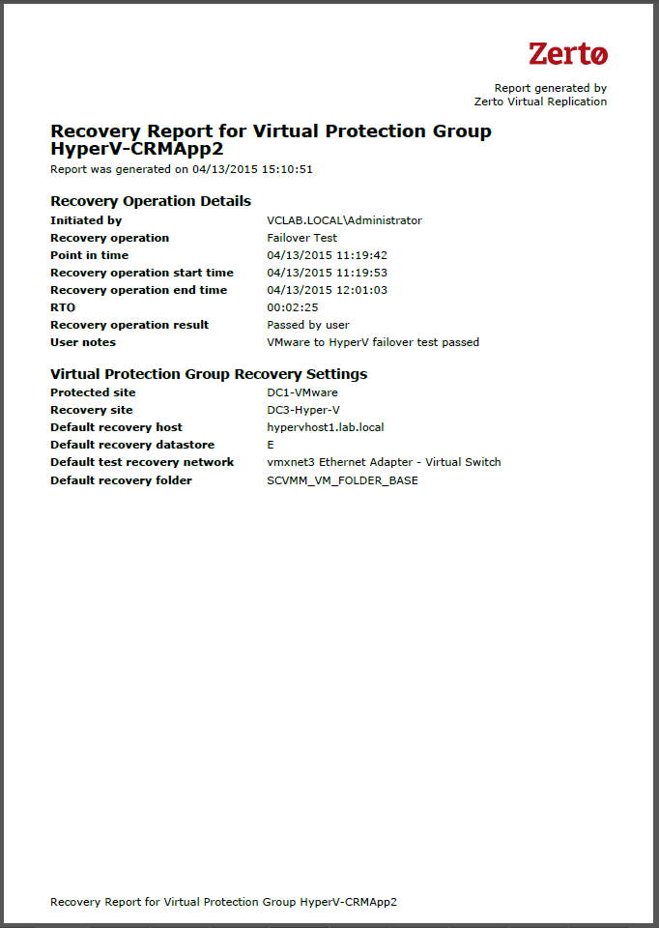
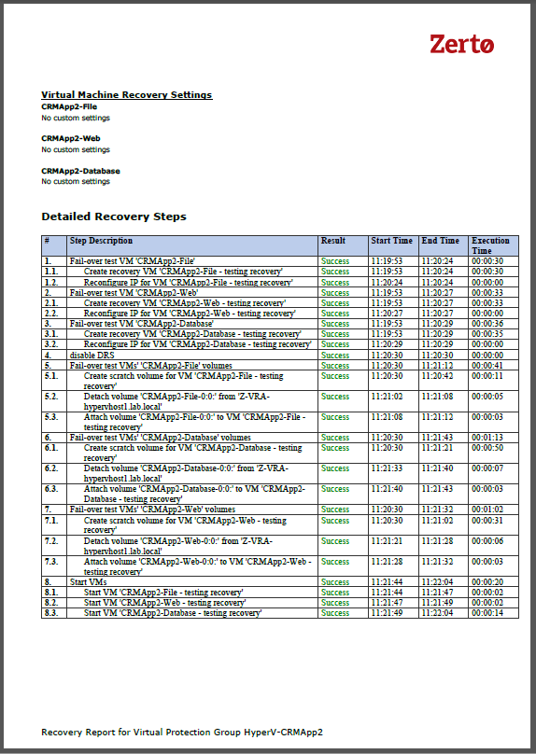
DR Test Reporting

Slide 22
Case Study: University of Louisville
“ We looked at both an array-based solution and a backup-based solution, but they just did not meet our needs in terms of the flexibility we required and the aggressive service levels we demand. We couldn’t make do with one or the other, we had to have both flexibility and enterprise-class SLAs – and with Zerto we have both.”
— Robert Patterson, Systems Administrator,University of Louisville Physicians
Challenges
Not change current processes and procedures
Not impact application performance
Enable the delivery of excellent patient care
Solution
Supports existing processes, easy to use
Installs seamlessly into existing infrastructure
Provides continuous, block-level replication with reverse protection
Exceeds service level agreements with very low RPOs and RTOs
“
Notes:
Disaster Avoidance strategy where they would migrate their applications from houston to Austin to avoid hurricane season. This migration would take 2 weekends of prep work and then one weekend to execute the migration.
With Zerto, they are able to complete this migration in 4 hours on Saturday morning.

Slide 23
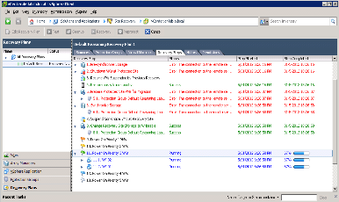
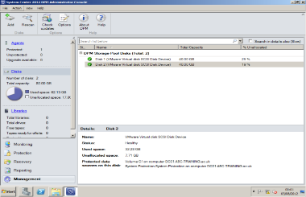

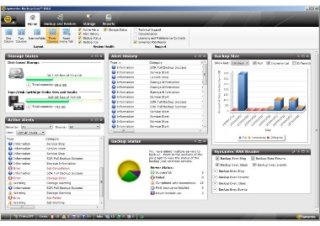
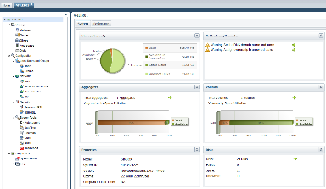
Before Zerto
Production Site
BC/DR Site
Recovery Automation
VM
VM
VM
VM
VM
VM
VM
VM
VM
VM
VM
VM
Continuous Data Protection
Offsite Backup
Replication

Slide 24
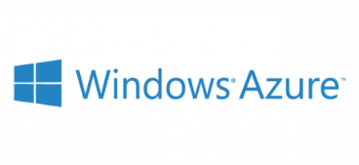












Evolving With IT
5.0
Public Cloud Storage/IaaS
Next Gen Apps PaaS
Enterprise IT
Zerto
Cloud Continuity Platform
MSP
On Premise Production Workloads
SaaS
Notes:
Oded – Also looking at:
KVM & Openstack
SaaS protection
Containers & Docker

Slide 25
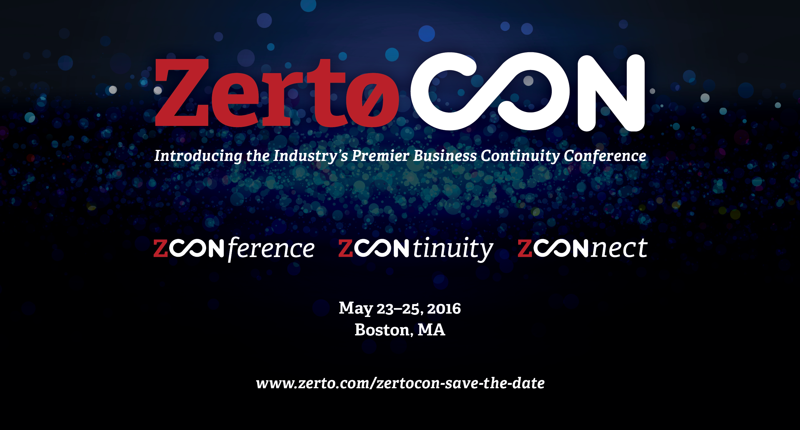

Slide 26
Before – Complex, Manual Replication Process
Example - Current replication configuration process for virtualized CRM
Local vCenter
Remote vCenter
Zza
Locate all VMs affecting CRM
Complex!
Map & Document All LUNs
Create and document recovery plan
Test recovery plan
Virtualization Team
Locate all VM Datastores
Consolidate CRM VMs on separate LUN
Storage
Manual!
Move all other app VMs to other LUNs
Consolidate all CRM VMs to same LUN
Document all LUN properties
Storage Team
Replication Management
Inflexible!
On going monitoring
Configure all replication pairs and entities
Verify replication
Remote Storage
Ensure sufficient space for replica
Allocate LUNs in replica with same properties
26

Slide 27
After – Automated Replication Process
Example - Current replication configuration process for virtualized CRM
Local vCenter
Remote vCenter
Locate all VMs affecting CRM
Configure verify replication and policies
Locate all VMs affecting CRM
Zza
Map & Document All LUNs
Create and document recovery plan
Test recovery plan
Virtualization Team
On going replication monitoring
Locate all VM Datastores
Consolidate CRM VMs on separate LUN
Storage
Move all other app VMs to other LUNs
Consolidate all CRM VMs to same LUN
Document all LUN properties
Storage Team
Replication Management
Configure all replication pairs and entities
Verify replication
On going monitoring
Remote Storage
Ensure sufficient space for replica
Allocate space for all replicated VMs
Ensure sufficient space for replica
Allocate LUNs in replica with same properties
27

Slide 28






Protect Any Cloud
Scalable Software
Strategic Solution
24/7 Global Support
Market Leader
Join the Zerto Revolution

